Slide 1


SmartPot
Tiberio Galbiati | Xiao Zifan | Jussi Pavainen | Tapio Immonen

Slide 2
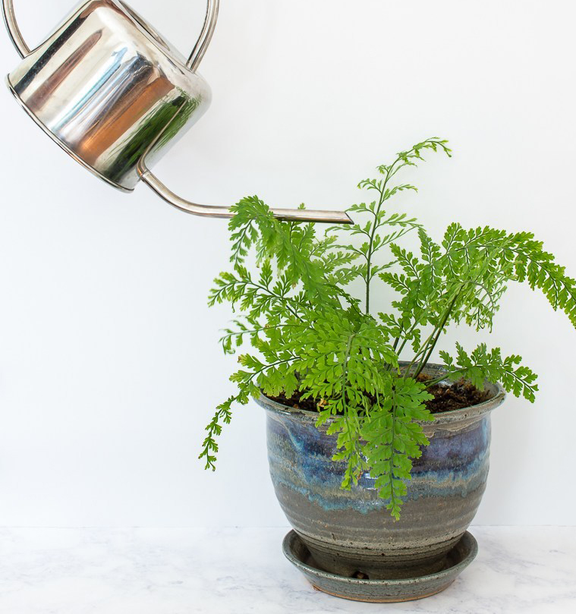

Never water
your flower
again by yourself!

Slide 4
I’ll Put here preliminary sketches

Slide 5
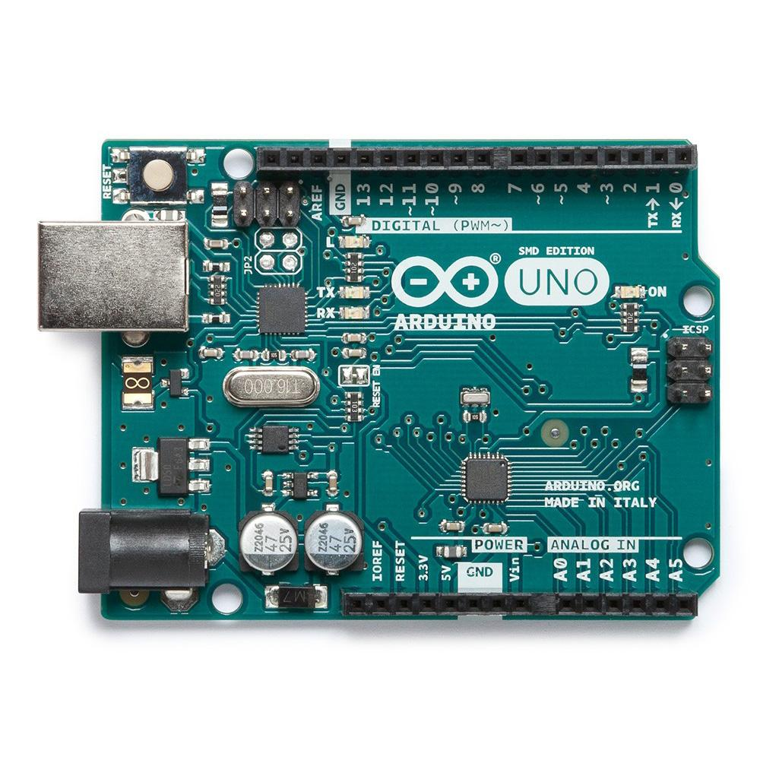
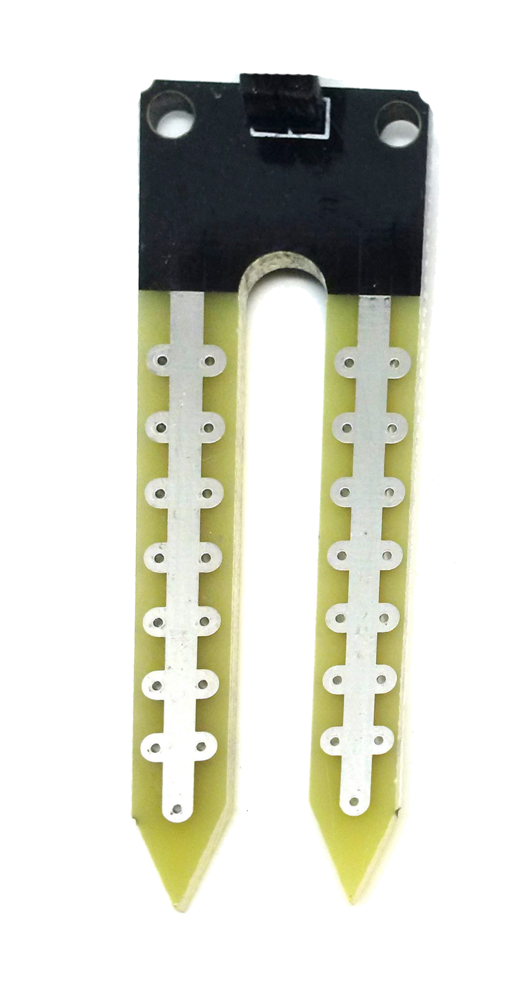
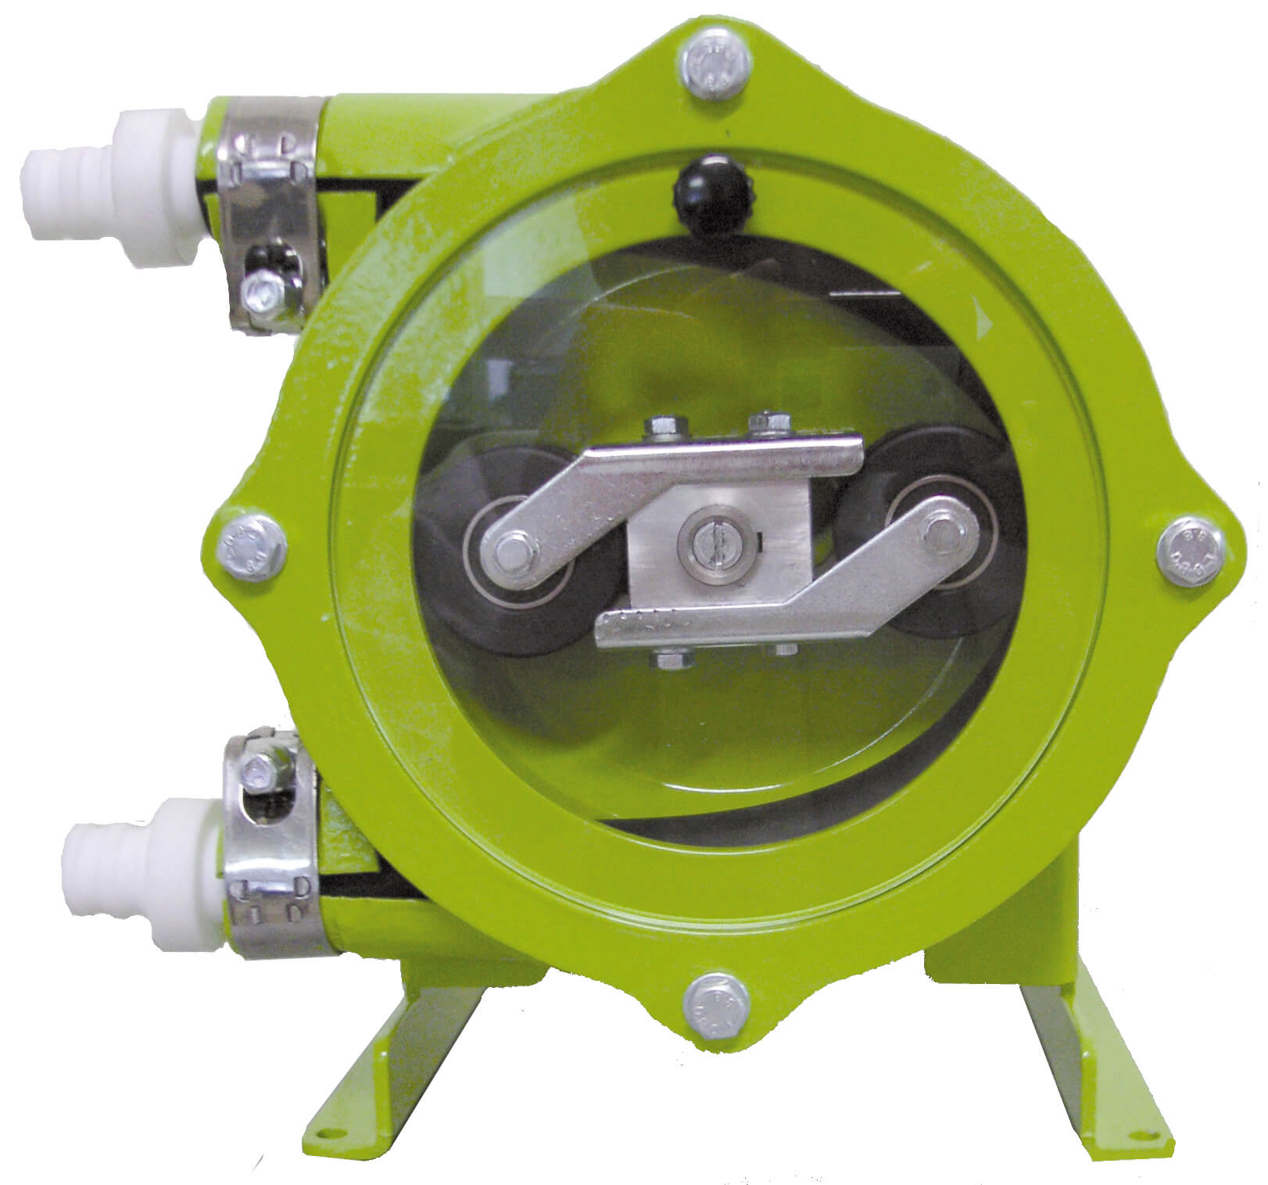
Elements
Capacitive moisture sensor
Arduino UNO
Peristaltic pump

Slide 6
Put here small video of exploding the project

